Slide 1
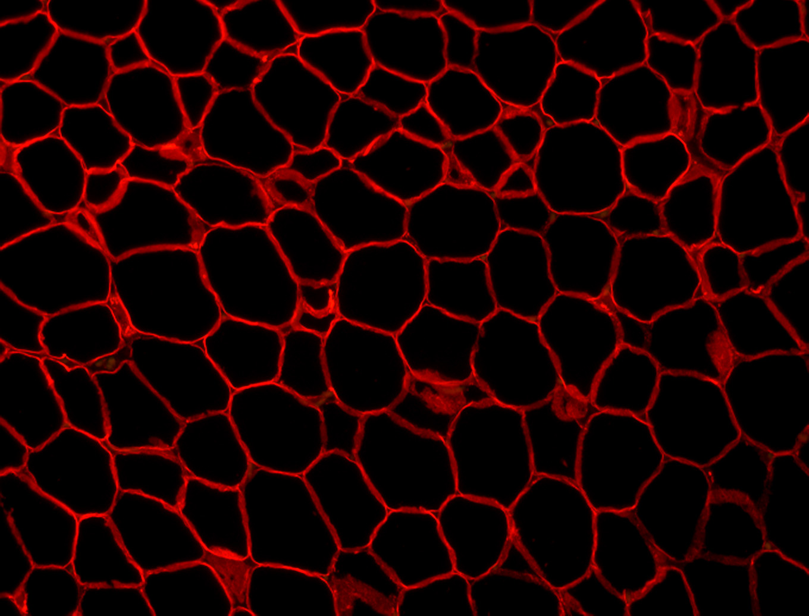
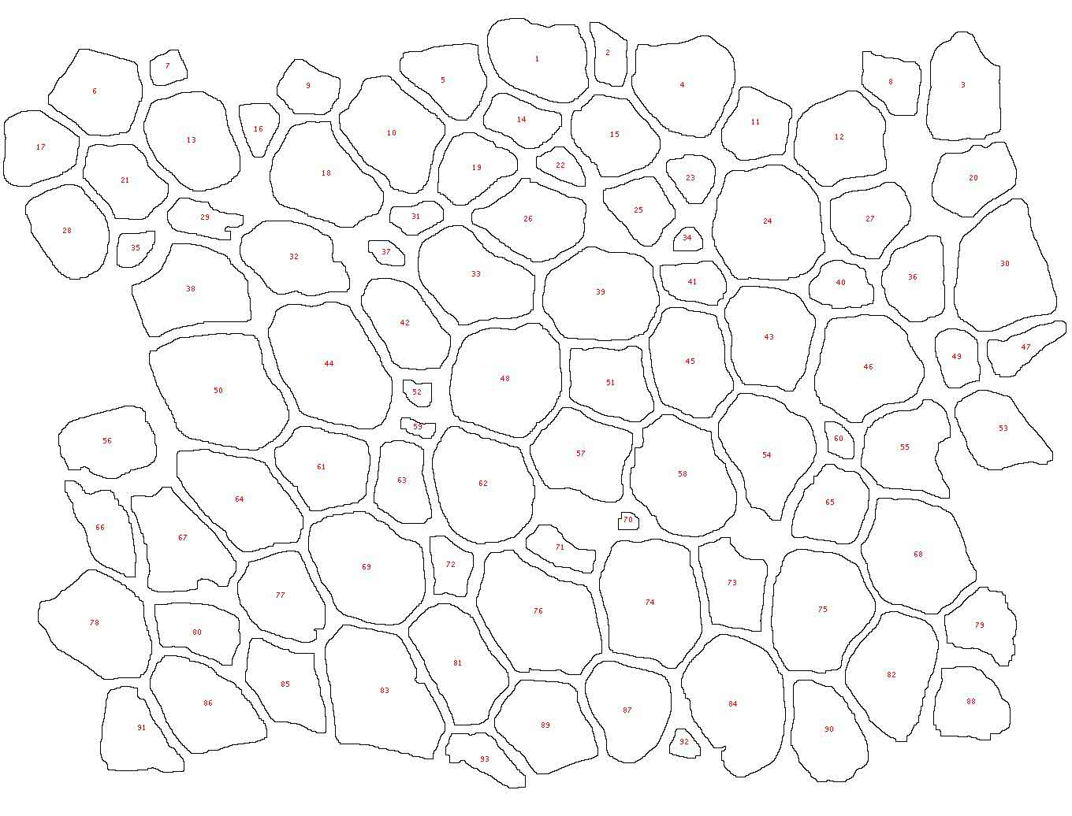
Fat tissue. Lipid droplets outlined in red.
Automated measurement of droplet area.
Results: Avg. area is 543.6μm^2
Avg. diameter is 25μm

